Slide 1
United Solar Finance || HR
Corey Jones and Damian Bryson
User Epics

Slide 2


DATA ACCESS
COREY JONES
DAMIAN BRYSON
Profile Read access to Products, Work Orders, Accounts, Contacts, Reimbursement Requests, and Payment Receipts, field-level Edit access to Status on Payment Receipts
Profile Read access to all objects except Certifications

Slide 3
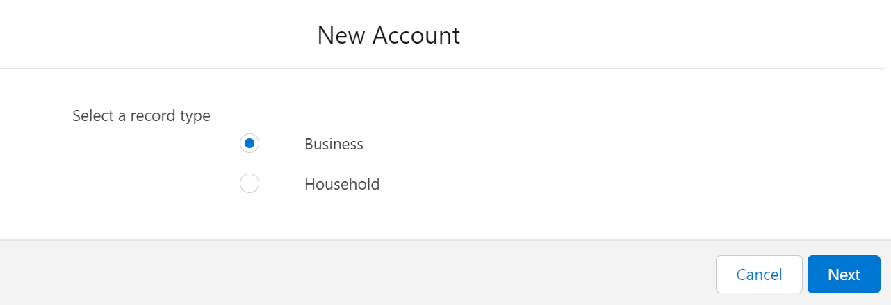
01
BUSINESSES VS. HOUSEHOLDS
Relevant information only for each
Record Tyes

Slide 4
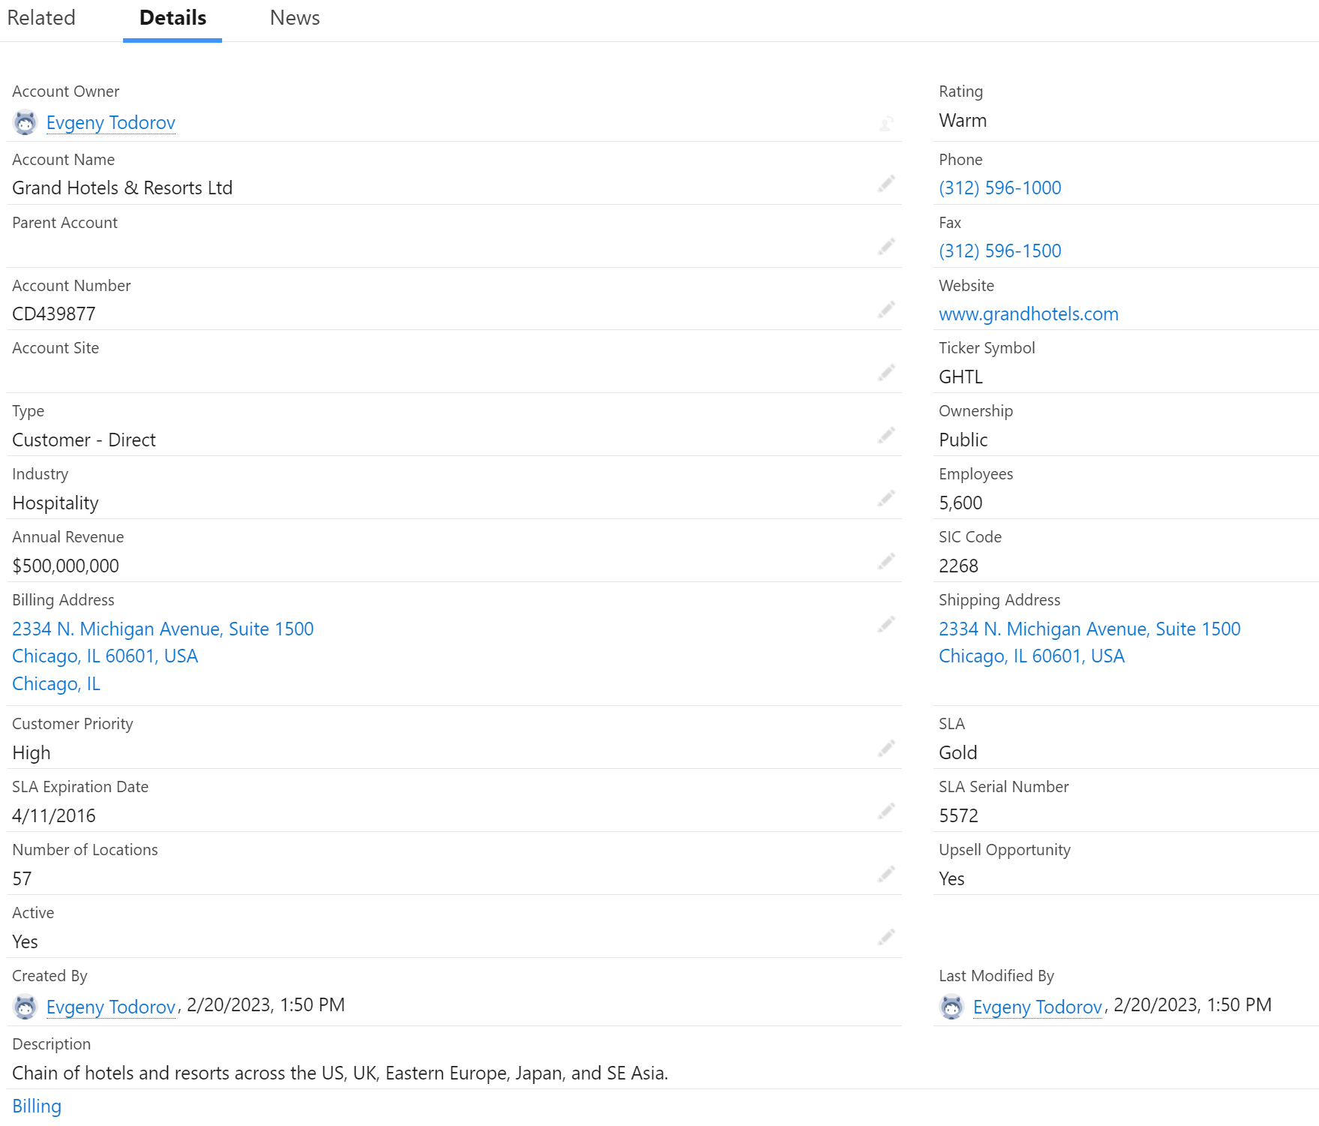
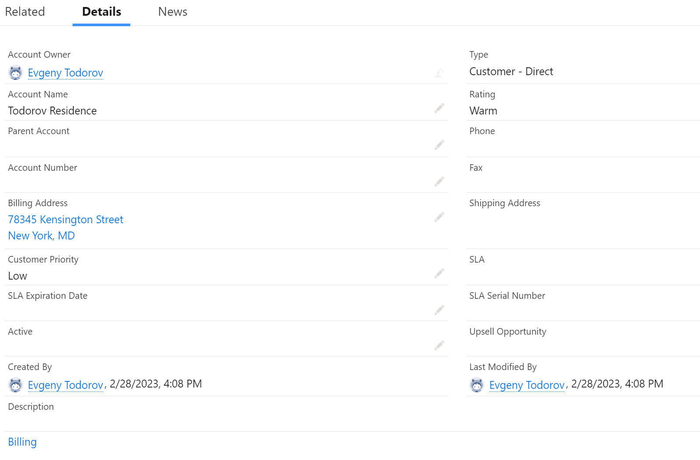
BUSINESSES VS HOUSEHOLDS
Page Layouts

Slide 5
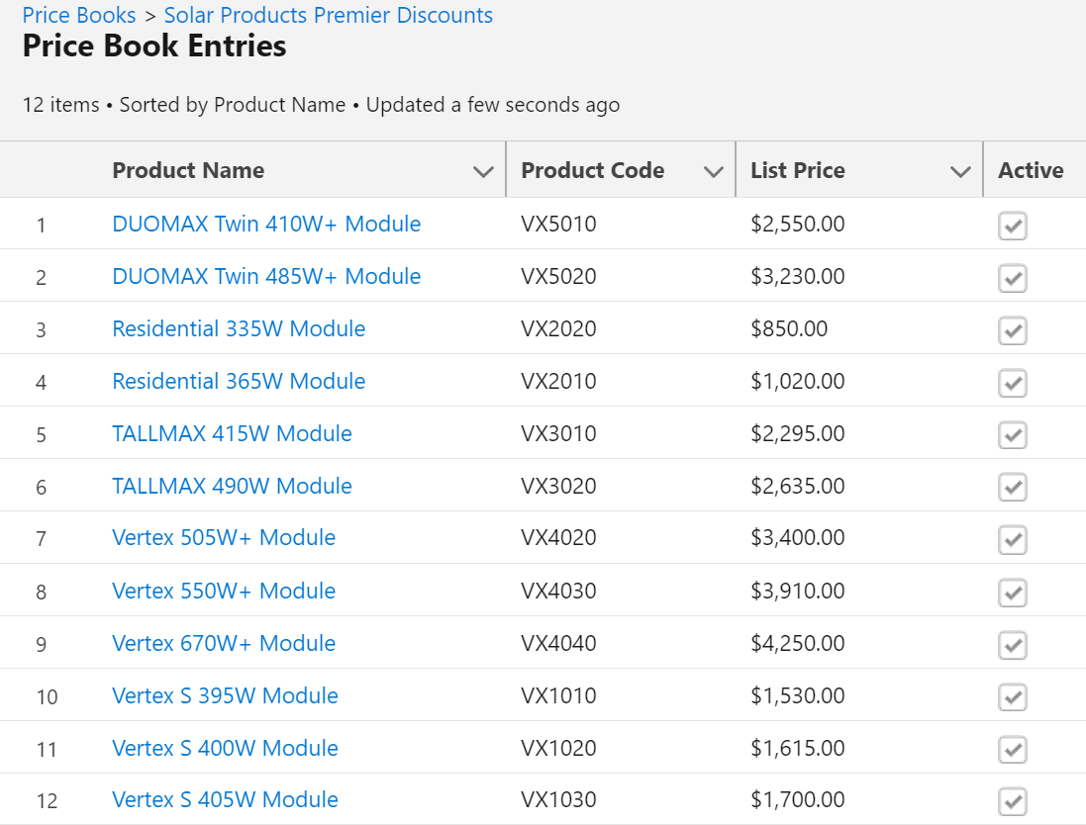
DISCOUNTED PRICE BOOK

Slide 6
Business Propositions – Charity Propositions
The sales process varies slightly for businesses versus charities.
Non-closed opportunity stages are omitted from the forecast category for charities and do not contribute to projected revenue as pipeline, best case, and commit forecast categories do for businesses.
Sales Processes and Picklist Values

Slide 7
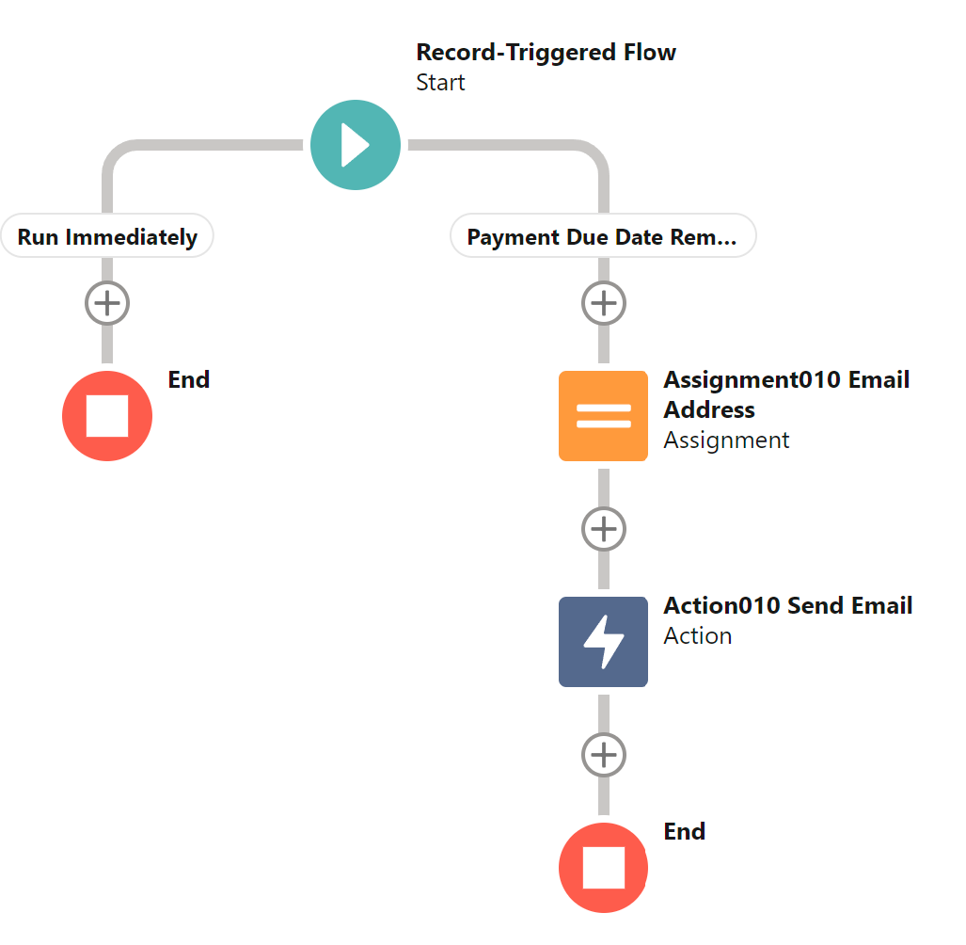
EMAIL REMINDER
Two days within the next payment due date the contact associated with the order is sent a reminder email.
Scheduled Path Record-Triggered Flow

Slide 8
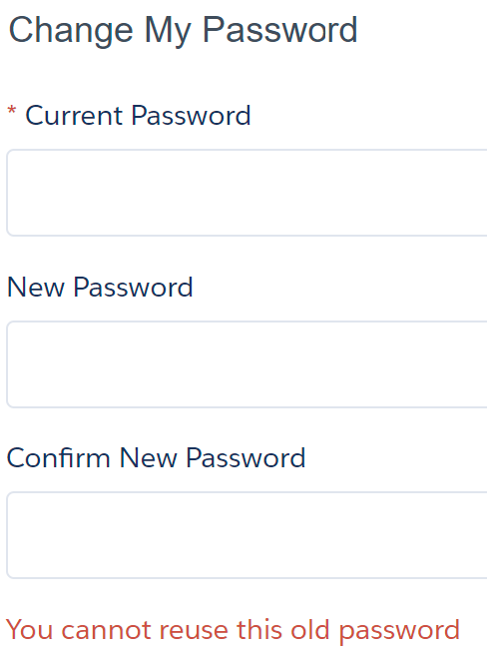
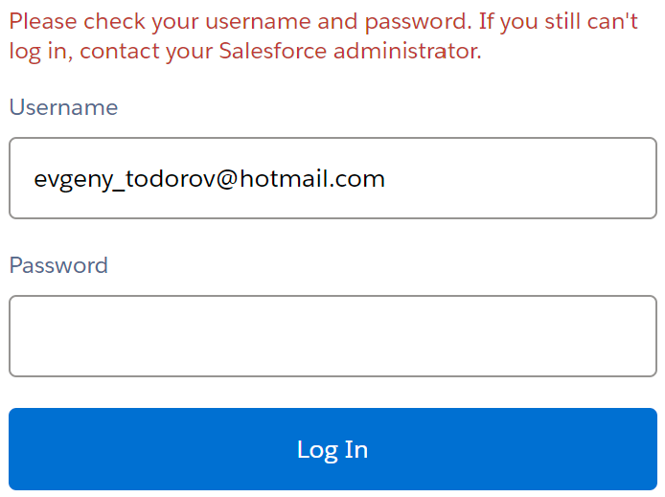
LOGIN SECURITY
DAMIAN’S BROAD DATA ACCESS REQUIRES GREATER SECURITY

